Slide 1

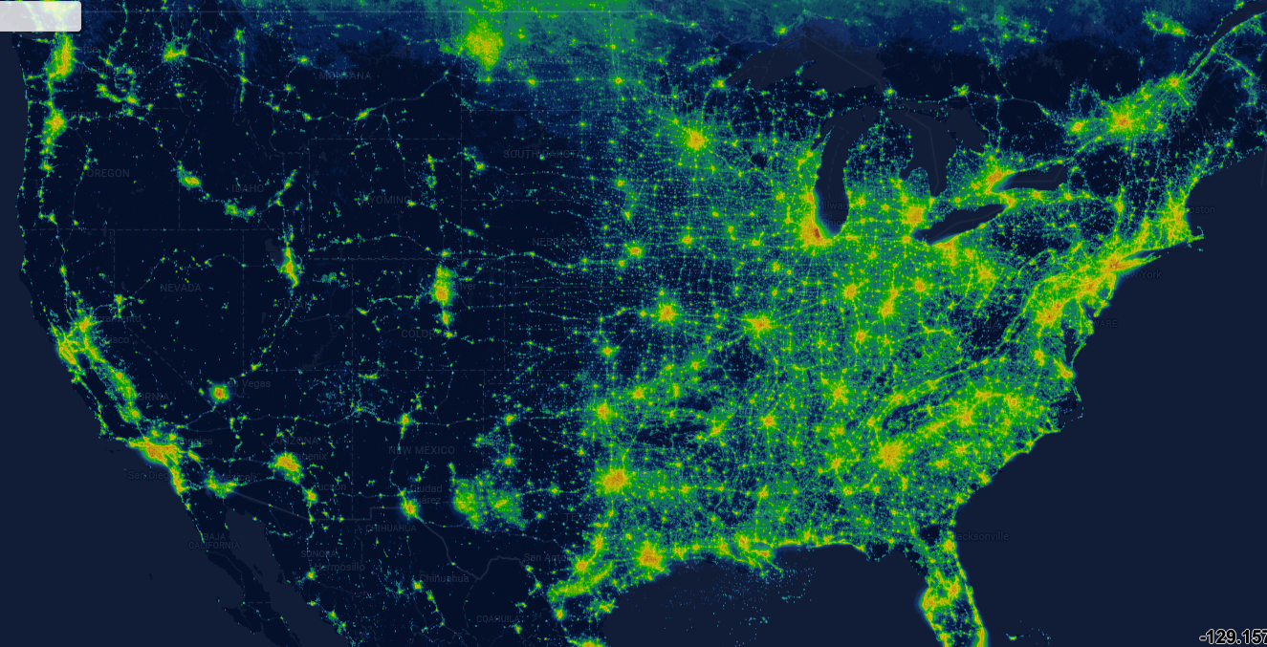
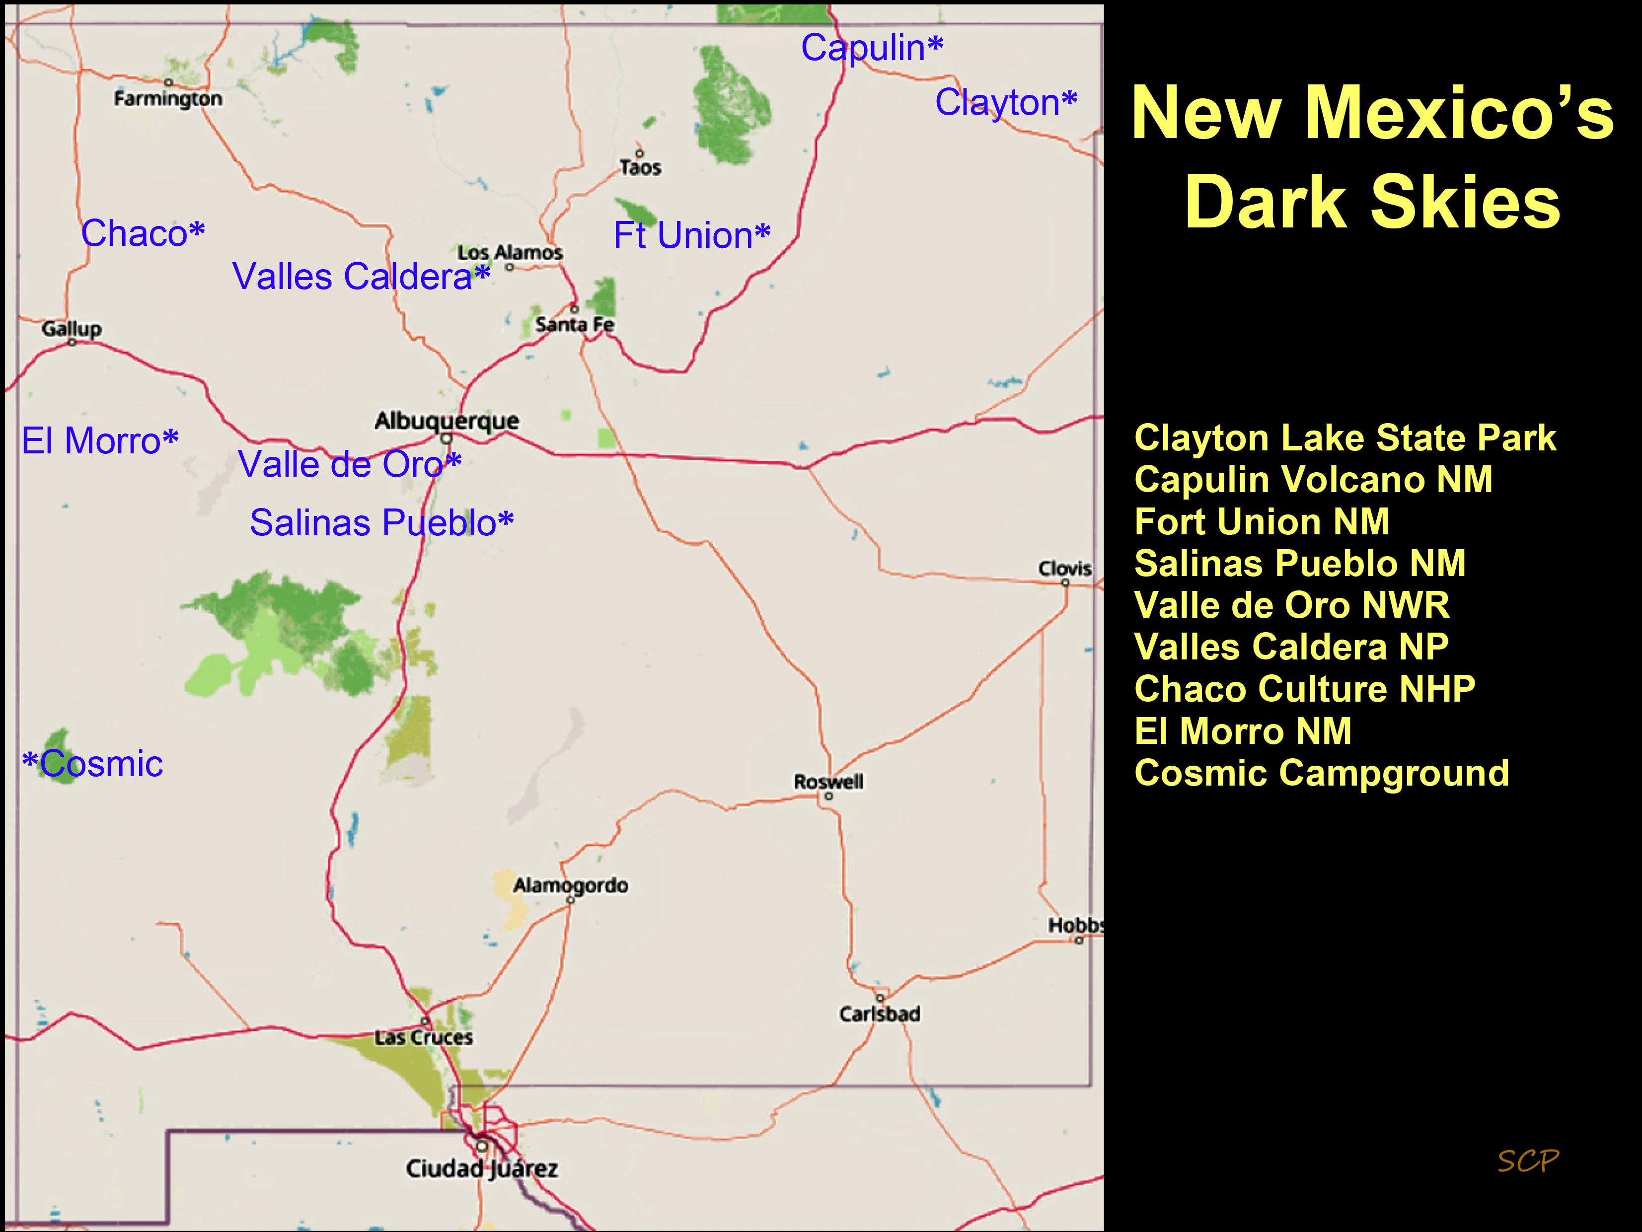
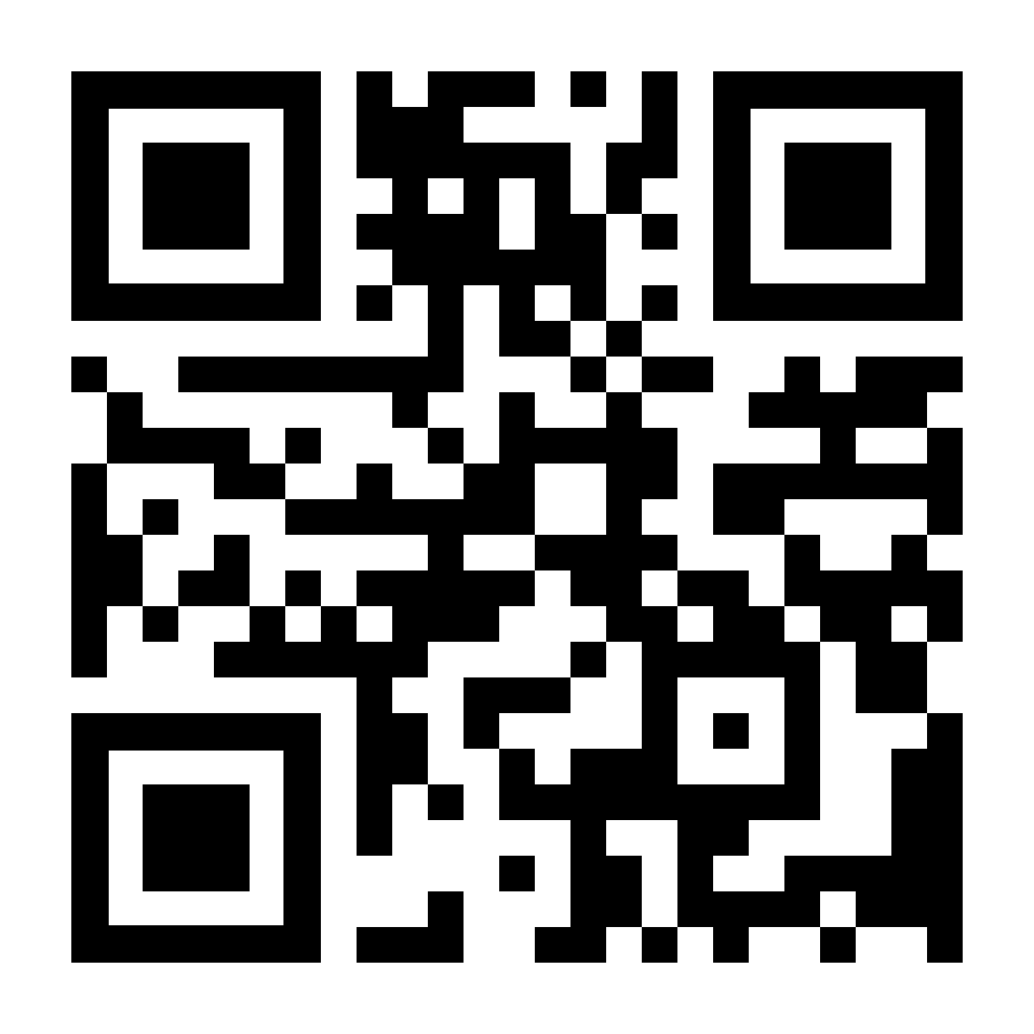
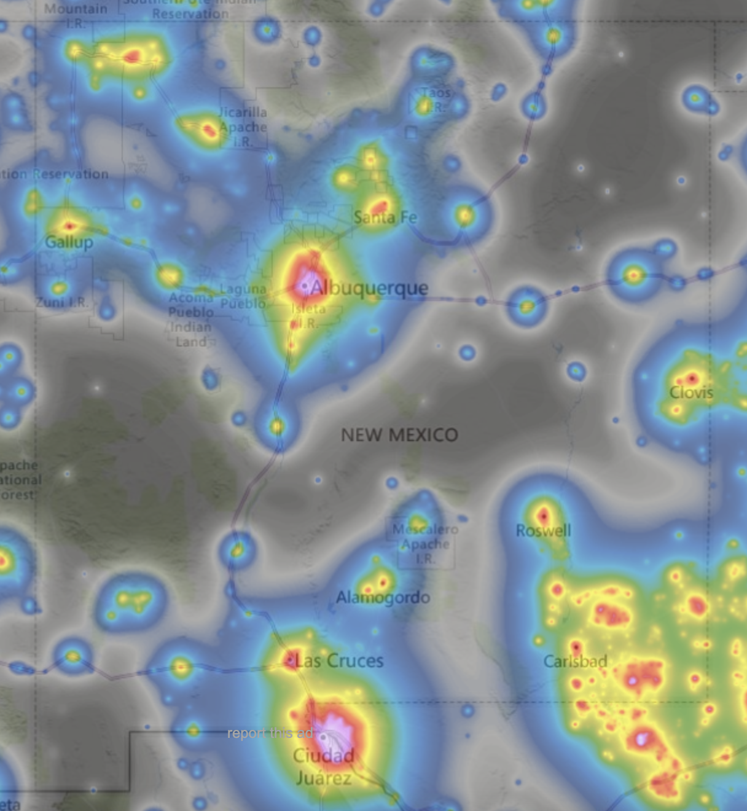
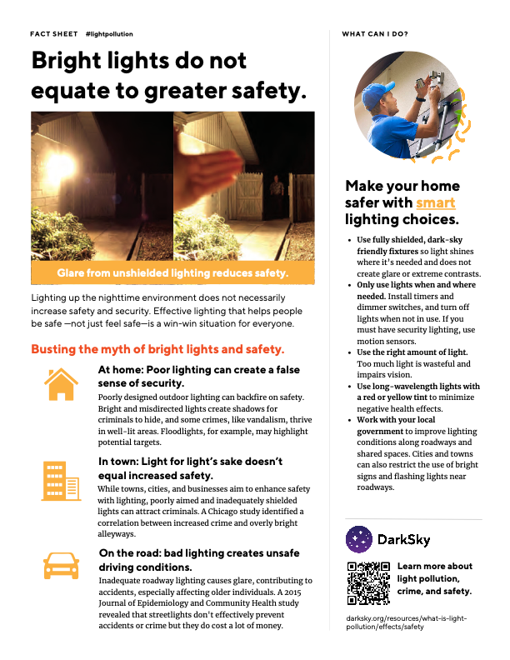
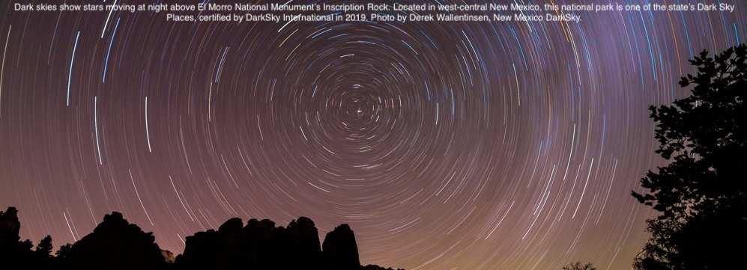
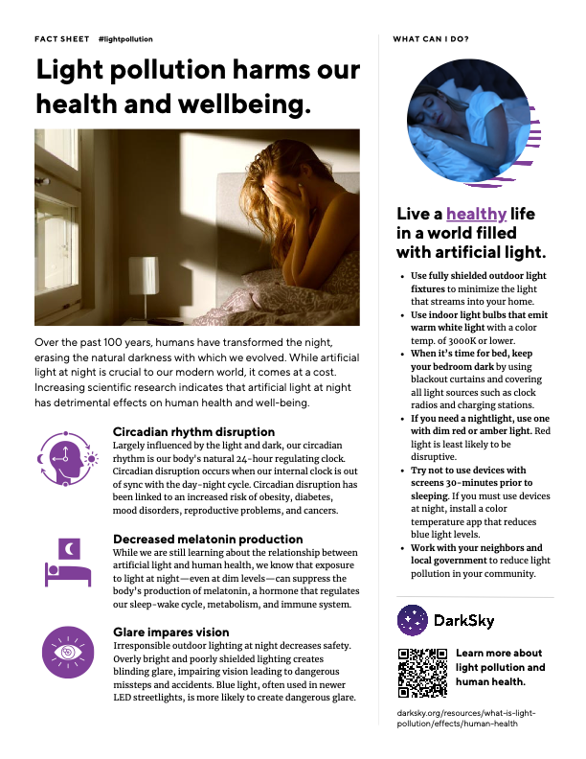
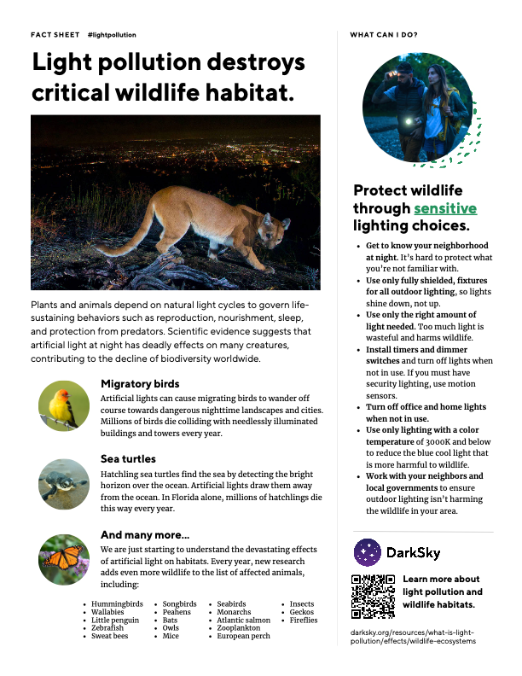
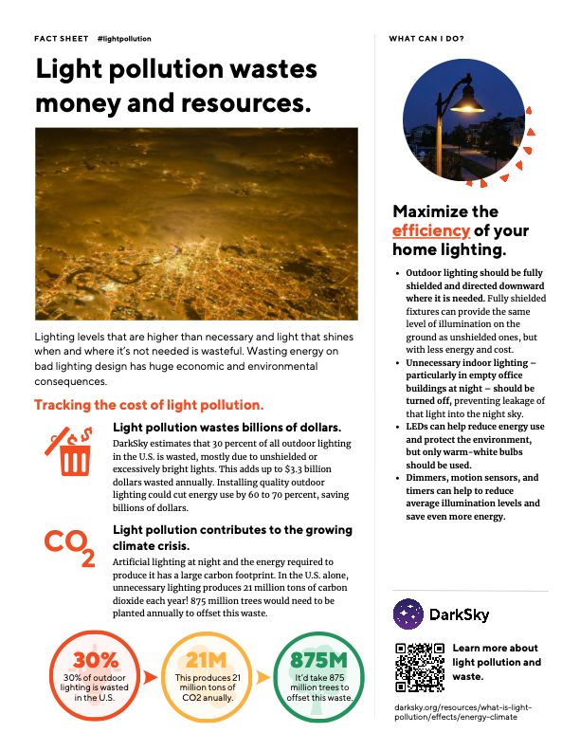
DarkSky Places in New Mexico
http://nmdarksky.org
Map shows brightness of the US at night Much of the US population doesn’t see dark skies!
Dark skies are a New Mexico resource
Map shows brightness of New Mexico at night. Darkest regions are shown in black, with blue, yellow, red, and white representing increasing night sky brightness. Note the main areas of light at night: Albuquerque/Santa Fe, El Paso/Juarez/Las Cruces,, and the SE and NW parts of the state, but also the large areas of dark skies!
To date, eight locations in NM have been designated as dark sky places, and one as an urban dark sky location; see map above. Effort is ongoing to get more designations!
Enjoy and Protect the Dark Skies of New Mexico!
New Mexico is one of only a few states with legislation that recognizes the value of dark skies: the Night Sky Protection Act. However, the Act is in need of updating and strengthening! Learn more and help!
http://nmdarksky.org

